Slide 1
CASE STUDY
#GROUP 7
COUNTRY
LEADER

Slide 2
# GROUP MEMBERS
M1 :- Pavan
M2 :- Sameer Shaik
M3 :- Yogesh Patel
M4 :- Chandana Sathwika
M5 :- Michael Yali

Slide 3
INTRODUCTION
The Constitution of a certain country states that the leader is the person with the name containing the greatest number of different alphabet letters. (The country uses the uppercase English alphabet from A - Z.) For example, the name GOOGLE has four different alphabet letters: E, G, L, and O. The name TCS has three different letters. If the country only consists of these 2 persons, GOOGLE would be the leader. If there is a tie, the person whose name comes earliest in alphabetical order is the leader.
Given a list of names of the citizens of the country, can you determine who the leader is ?

Slide 4
ALGORITHM
1. START
2. ENTER THE COUNTRY LEADER NAMES
3. ADD THE NAMES INTO AN ARRAY LIST
4. FIND LEADER(NAMES) IS CALLED
5. LEADER IS DECLARED AS A STRING AND ASSIGNED AS NULL.
6. REMOVE ALL WHITE SPACES USING REPLACE ALL
7. MAP THE CHARACTERS USING HASHMAP
8. COUNT THE DIFFERENT CHARACTERS IN THE INPUT NAME
9. COMPARE THE COUNT OF DIFFERENT CHARACTERS OF BOTH NAMES AND PRINT THE LEADER NAME.
10. STOP

Slide 5
INPUT
2
2
PYTHON JAVA
2
SAMEER MICHAEL
TOTAL TEST CASES YOU WANT
Total Entries in First Case
Insert Citizen Names
Total Entries in Second Case
Insert Citizen Names

Slide 6
PROGRAM
package com.company; import java.io.*; import java.util.*; public class CountryLeader { public static void main(String[] args)
{ Scanner in = new Scanner(new BufferedReader(new InputStreamReader(System.in))); System.out.println("v"); int t = in.nextInt(); in.nextLine();
for (int i = 1; i <= t; ++i)
{ int n = in.nextInt(); in.nextLine(); List<String> names = new ArrayList<String>(); for (int j = 0; j < n; ++j) { names.add(in.nextLine()); }
System.out.println("Case #" + i + ": " + findLeader(names)); } }
public static String findLeader(List<String> names) { String leader = ""; int maxCount = 0; for (String name : names) { String current = name.replaceAll(" ","");; char[] charArr = current.toCharArray(); int counter = 0; Map<Character, Boolean> charMap = new HashMap<Character, Boolean>(); for (Character ch : charArr) { if (charMap.containsKey(ch)) { continue; } else { charMap.put(ch, true); counter++; } } if (maxCount < counter) { leader = name; maxCount = counter; } } return leader; } }

Slide 7
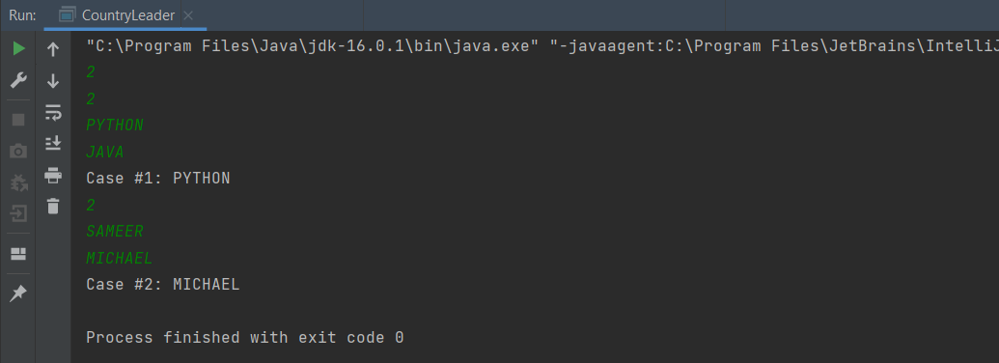
OUTPUT

Slide 8


system.out.println(“THANK YOU");

